Slide 1
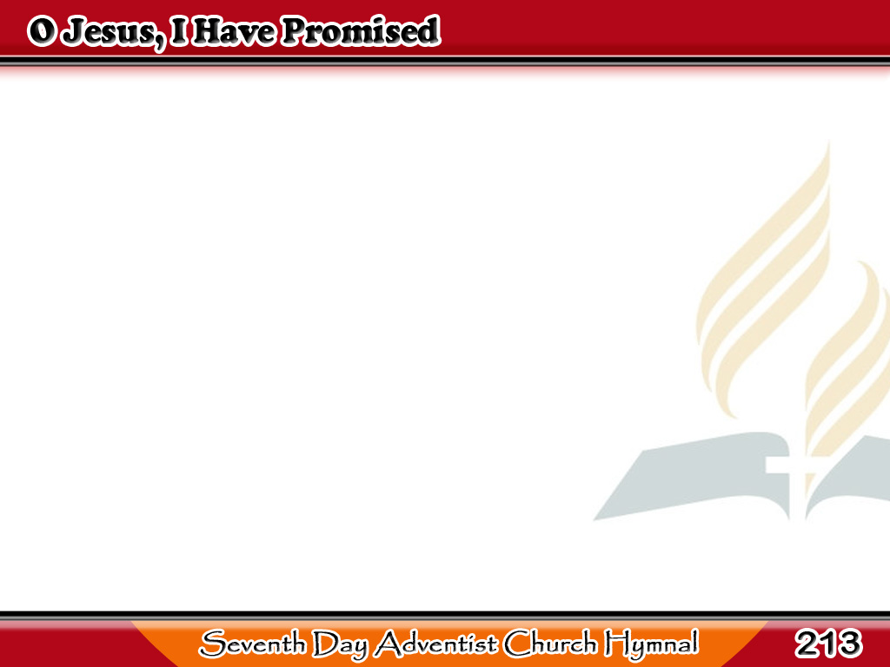
Jesus, Nangako Ako
O Jesus, I have promised
To serve Thee to the end;
Be Thou forever near me,
My Master and my Friend;
1/3

Slide 2
Jesus, Nangako Ako
I shall not fear the battle
If Thou art by my side,
Nor wander from the pathway
If Thou wilt be my Guide.
1/3

Slide 3
Jesus, Nangako Ako
O let me feel Thee near me;
The world is ever near!
I see the sights that dazzle,
The tempting sounds I hear;
2/3

Slide 4
Jesus, Nangako Ako
My foes are ever near me,
Around me and within;
But Jesus, draw Thou nearer,
And shield my soul from sin.
2/3

Slide 5
Jesus, Nangako Ako
O Jesus, Thou hast promised
To all who follow Thee
That where Thou art in glory
There shall Thy servant be;
3/3

Slide 6
Jesus, Nangako Ako
And, Jesus, I have promised
To serve Thee to the end;
O give me grace to follow
My Master and my Friend.
3/3

